Slide 1
Comparative Analysis on Credit Risk Modelling System Using Machine Learning And Deep Learning Techniques
Presented By:
Susmita Jana
M.Sc. Data Science

Slide 2
INTRODUCTION
Credit risk modeling refers to data driven risk models which calculates the chances of a borrower defaults on loan
Importance of Credit Risk Management in the Financial Industry
Credit risk modeling helps financial institutions evaluate borrower default risk, enabling informed lending decisions, reducing financial losses, and maintaining stability.

Slide 3
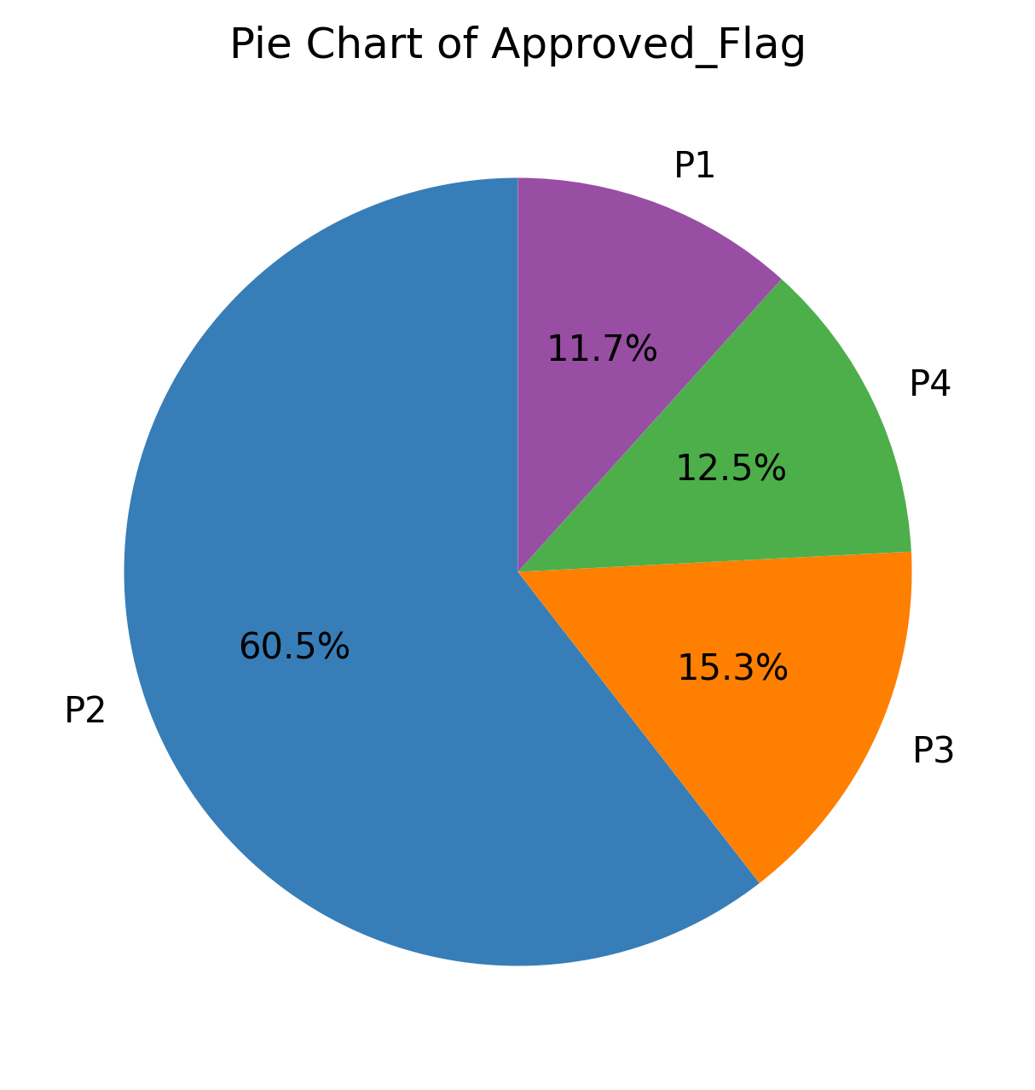
Objective
Identify the most effective ML and DL models for accurately predicting credit risk levels, ranging from P1 (low risk) to P4 (high risk).
P1: Low Risk
P2: Moderate Risk
P3: Elevated Risk
P4: Highest Risk
Fig. Pie chart of Approved Flag

Slide 4
Related Work
Author | Model | Dataset
Jane Smith, Michael Brown, Emily Johnson[3] | Logistic Regression, Random Forest, Gradient Boosting | Public
Martin VOJTEK – EvÏen KOâENDA[7] | LDA, KNN, MLP | private
Jacky C. K. Chow [4] | SVM, AdaBoost, ANN | Public
Alice Doe, Bob Smith, Carol Johnson[6] | LSTM,CNN,GBM | private

Slide 5
Why?
Many financial institutions focus primarily on credit scoring. Traditional credit scoring methods often rely on below two models
Logistic Regression:
Assumes linear relationships.
Struggles with complex nonlinear patterns.
Decision Trees:
Captures nonlinear relationships.
Prone to overfitting.

Slide 6
PROJECT WORK FLOW
Data Collection
Data Exploration
Data Preprocessing
Feature Selection
Results and Evalution
Hyperparameter Tuning
Apply ML/DL Models
Data Splitting

Slide 7
Data Collection
We collected the data from this site [9]
Data Description
The dataset comprises two comprehensive CSV files.
Bureau Dataset: This file contains 51,336 rows , 26 columns. It provides detailed information about the trade lines of credit applicants, focusing on their credit activities.
Cibil Dataset: This file contains 51,336 rows and 62 columns. It focuses on the delinquency patterns, credit inquiries, and various financial behaviors of the applicants. Of these columns, 6 are categorical and 56 are numerical.
Notes:
Data Collection

Slide 8
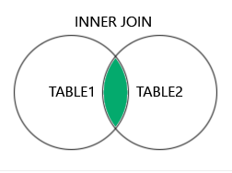
Data Preprocessing
Missing Values handling
Some columns of Cibil dataset contains more than 20%
Fig . Merging Two dataset
42064 rows, 79 columns

Slide 9
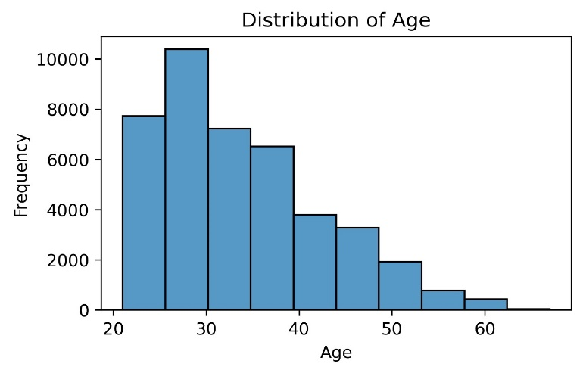
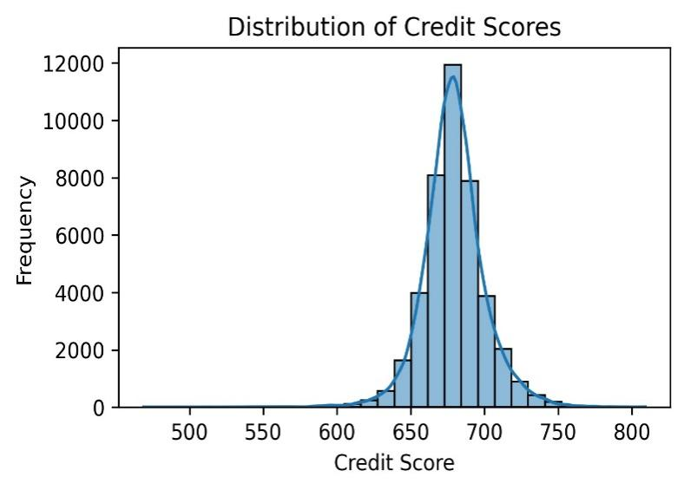
Data Exploration
Fig. Distribution of Credit Score
Fig. Distribution of Age

Slide 10
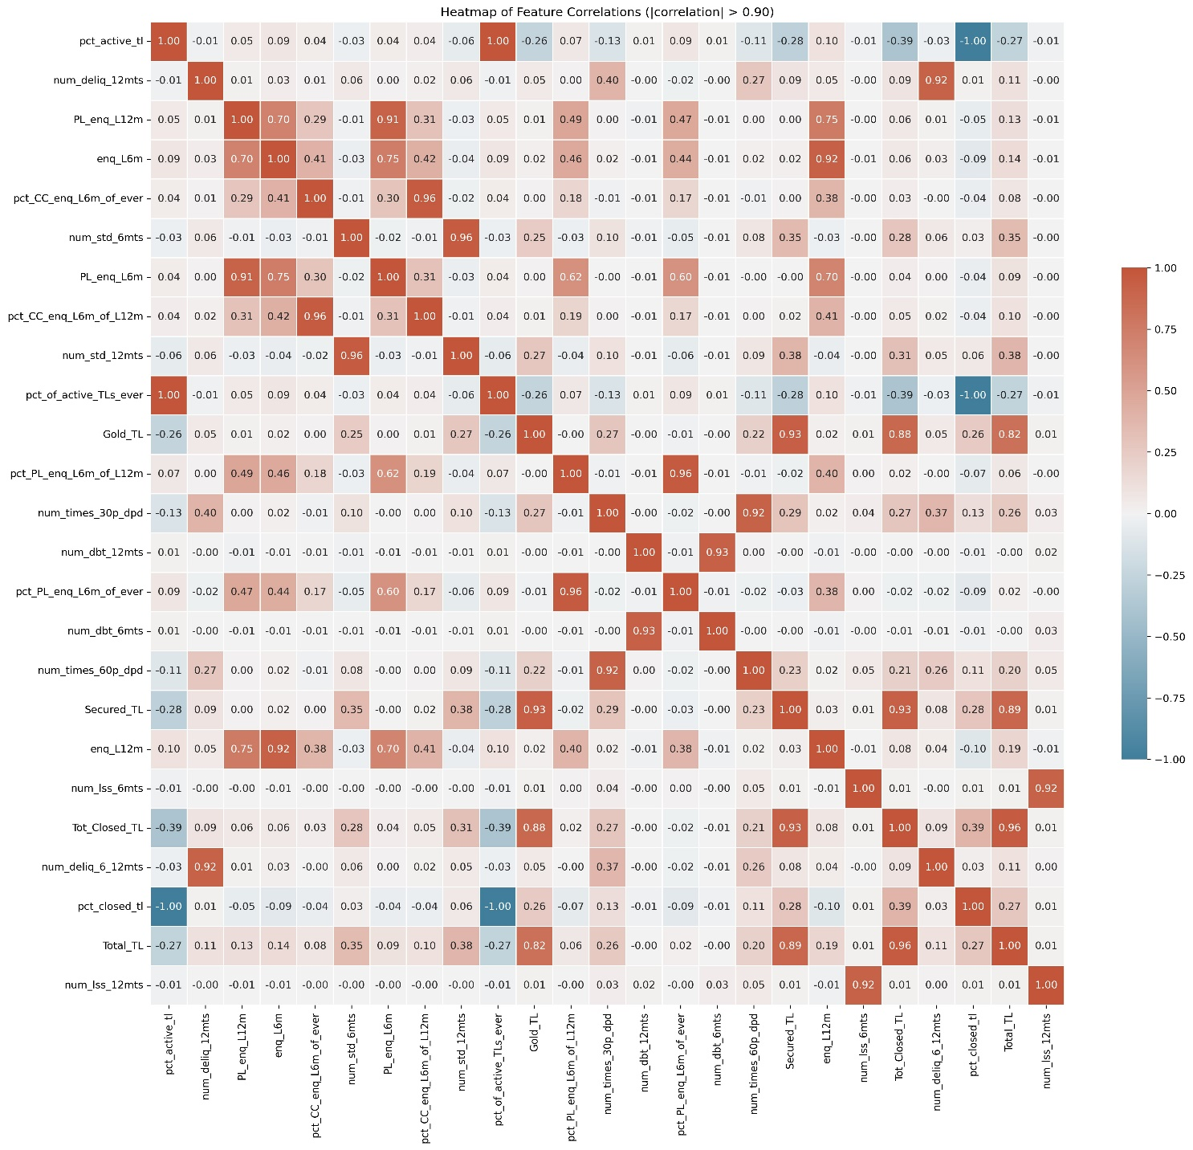
Correlation Analysis of Features
Fig. Heatmap of the correlations

Slide 11
Categorical Feature Preprocessing
Chi-Square Test
Custom Label encoding for EDUCATION
Label encoding for Approved Flag
One-hot encoding for rest
Columns Name | P-value
MARITALSTATUS | 3.58e⁻²³³
EDUCATION | 2.69e⁻³⁰
GENDER | 1.91e⁻⁵
Last_prod_enq2 | 0
First_prod_enq2 | 7.85e⁻²⁸⁷

Slide 12
Numerical Feature Preprocessing
Removing Multicollinearity
num_deliq_12mts and pct_closed_L12m: 0.92
PL_enq_L12m and PL_enq_L16m:0.92
gold_tl and Secured_Tl 0.93
num_times_60dpd_6mts and num_dbt_6mts: 0.92
Total_TL and num_tls_12mts: 0.92
We Choose Threshold: 0.85

Slide 13

Dataset Splitting (ML MODEL)
Dataset Splitting (DL MODEL)
Train(80%)
Test(20%)
Train(70%)
Validation
(15%)
Test(15%
Class Weights$=\frac{Total no. of Samples}{4∗Number of samples in each class}$
Feature scaling: StandardScaler
feature selection process is not biased by feature scales

Slide 14
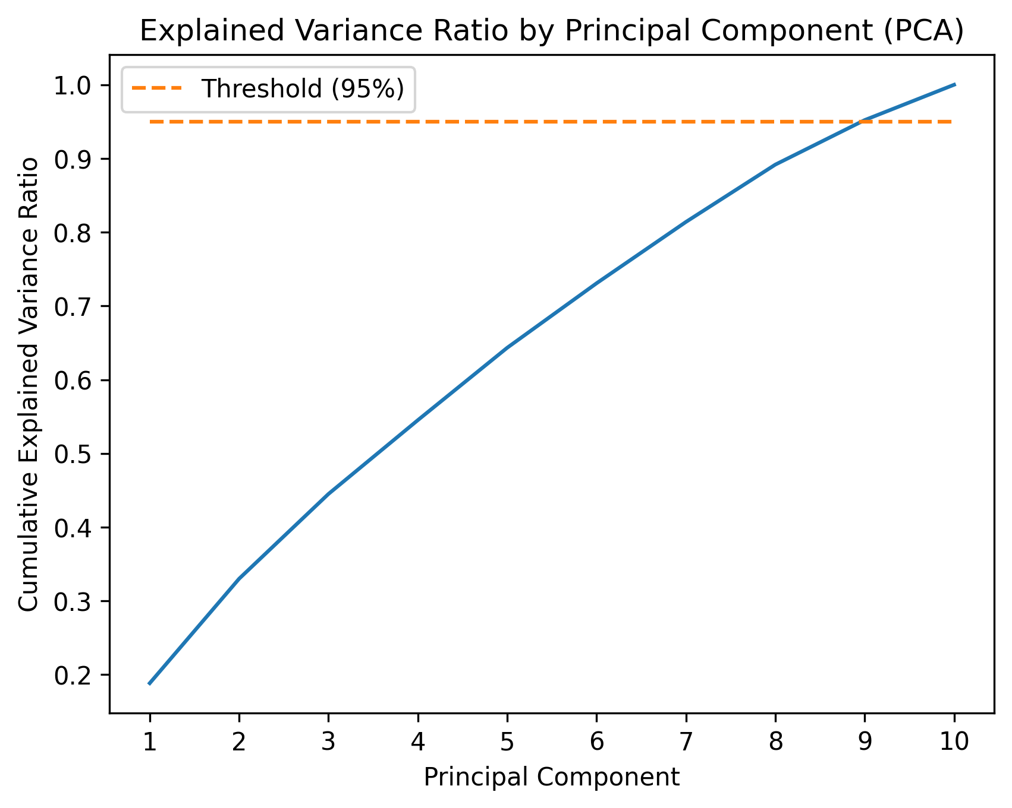
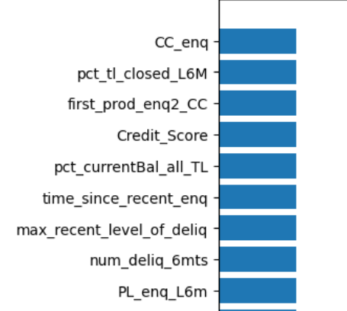
Feature Selection
By Recursive Feature Elimination We Select top 10 features
Fig. Principal Components Vs Cumulative Explained Variance Ratio

Slide 15
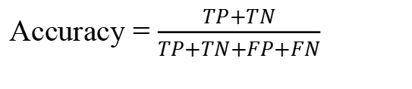



Evaluation Metrics
Accuracy = $\frac{TP+TN}{TP+TN+FP+FN}$
Precision= $\frac{TP}{TP+FP}$
Recall= $\frac{TP}{TP+FN}$
$$F1 Score=\frac{Precision X Recall}{Precision+Recall}∗2$$

Slide 16
Comparison of the Results of various ML Models
MODEL | Accuracy (%) | Precision (%) | Recall (%) | f1-Score(%)
XGBoost | 94.28 | 94.18 | 94.28 | 94.19
Random Forest | 94.01 | 93.91 | 94.01 | 93.90
LightGBM | 93.85 | 93.74 | 93.85 | 93.72
SVM | 93.88 | 93.74 | 93.88 | 93.73

Slide 17
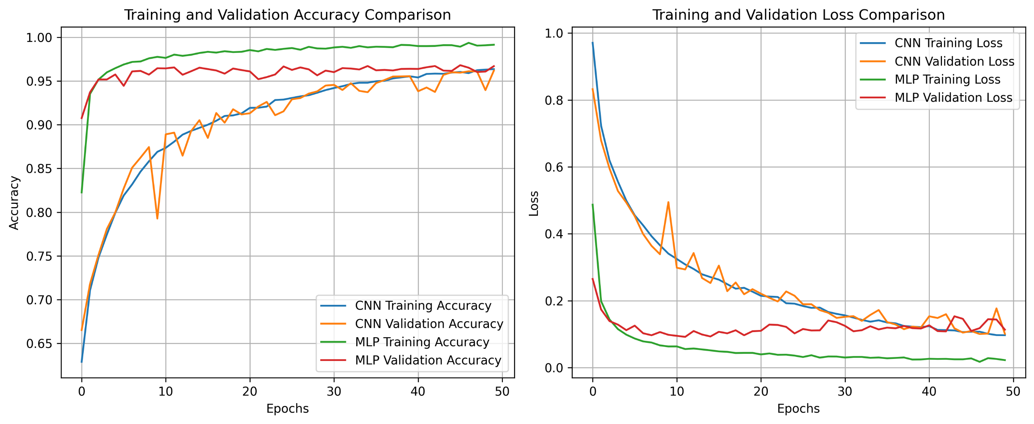
Comparison of the Results of various DL Models
Fig. Training Accuracy Vs Validation Accuracy
Fig. Training Loss Vs Validation Loss

Slide 18
Comparison of the Results of various DL Models
MODEL | Accuracy (%) | Precision (%) | Recall (%) | f1-Score(%)
CNN | 97.83 | 96.39 | 96.69 | 96.52
MLP | 96.61 | 96.60 | 96.61 | 96.60

Slide 19
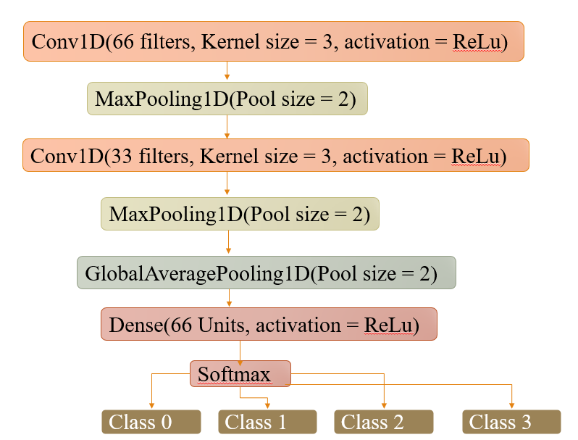
Model Architecture (1D CNN)
INPUT(66,1)

Slide 20
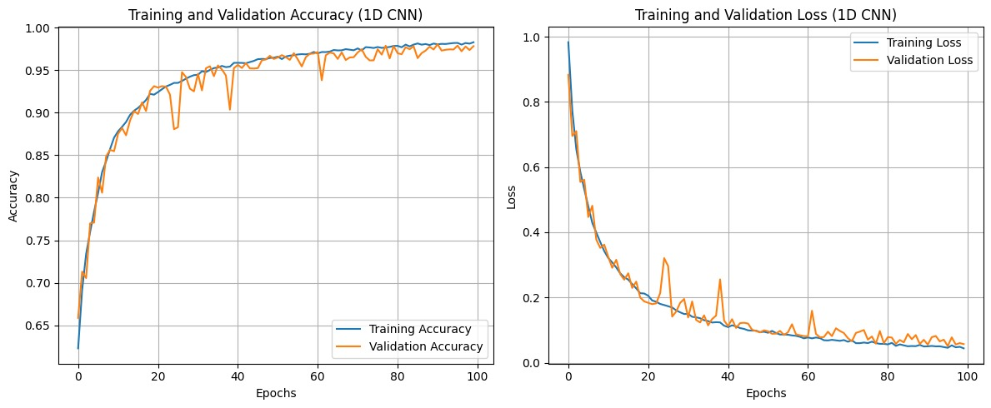
Best DL Model
Fig. Training Accuracy Vs Validation Accuracy
Fig. Training Loss Vs Validation Loss

Slide 21
Best Hyperparameters
ML Model
DL Model
Learning Rate | 0.2
Max depth | 7
Min child weight | 5
n estimators | 300
subsample | 0.8
Batch Size | 32
Optimizer | Adam
Loss | Categorical cross- Entropy
No. of Epoch | 100
Activation Function | Relu
Learning Rate | 0.001

Slide 22
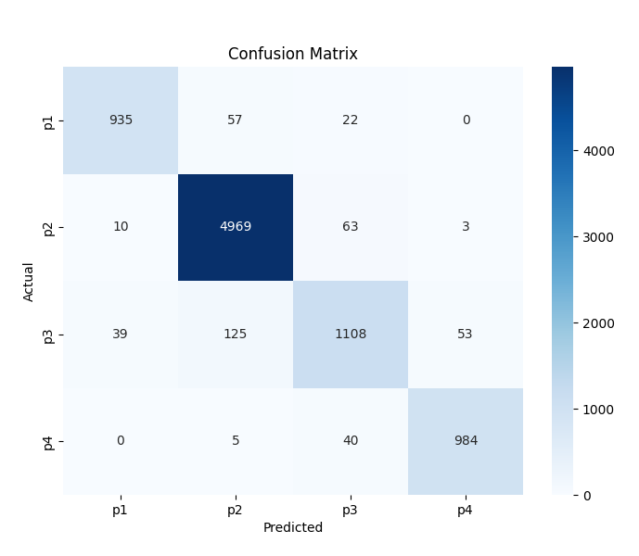
Result of Best ML Model
Class | Accuracy (%) | Precision (%) | Recall (%) | F1 Score (%)
P1 | 92.21 | 95.02 | 92.21 | 93.59
P2 | 98.49 | 96.37 | 98.49 | 97.42
P3 | 83.62 | 89.86 | 83.62 | 86.63
P4 | 95.63 | 94.62 | 95.63 | 95.12
Overall | 95.04 | 94.01 | 94.28 | 94.19
Fig: Confusion Matrix

Slide 23
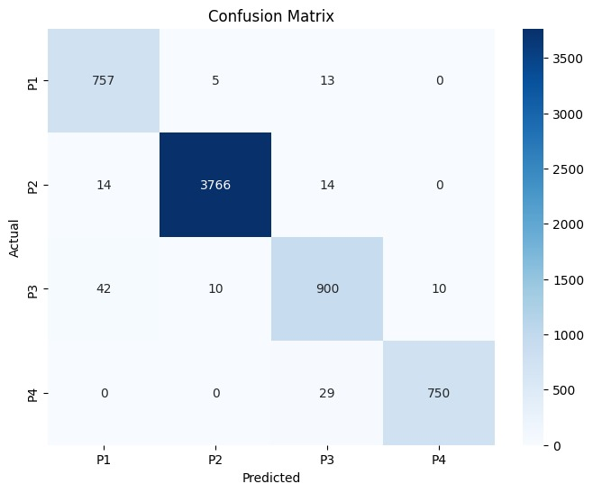
Best DL Model Result
Class | Accuracy | Precision | Recall | F1 Score
P1 | 97.68 | 93.11 | 97.67 | 95.34
P2 | 99.26 | 99.60 | 99.26 | 99.43
P3 | 93.56 | 94.14 | 93.55 | 93.84
P4 | 96.28 | 98.68 | 96.27 | 97.46
Overall | 97.83 | 96.39 | 96.69 | 96.52
Fig: Confusion Matrix

Slide 24
FUTURE WORK
Since our model does not generalize well for the P3 class, we will explore combining multiple models.

Slide 25
References
[1] Thomas, L. C., Edelman, D. B., & Crook, J. N. (2002). Credit Scoring and Its Applications. SIAM.
[2] Altman, E. I. (1968). Financial Ratios, Discriminant Analysis and the Prediction of Corporate Bankruptcy. The Journal of Finance, 23(4), 589-609.
[3] Jane Smith, Michael Brown, Emily Johnson ,[2020] Predicting the deforestation probability using the binary logistic regression, random forest, ensemble rotational forest, REPTree: A case study at the Gumani River Basin, India
[4] Jacky C.K. Chow [2017],Analysis of Financial Credit Risk Using Machine Learning.
[5] Huang, C. L., Chen, M. C., & Wang, C. J. (2007). Credit scoring with a data mining approach based on support vector machines. Expert Systems with Applications, 33(4), 847-856.
[6] A comprehensive investigation of LSTM-CNN deep learning model for fast detection of combustion instability,[2021].Alice Doe, Bob Smith,Carol Johnson
[7] Credit-Scoring Methods,[2006]Martin VOJTEK – EvÏen KOâENDA*
[8] Xia, Y., Liu, C., Li, Y., & Liu, N. (2017). A boosted decision tree approach using Bayesian hyper-parameter optimization for credit scoring. Expert Systems with Applications, 78, 225-241.
[9]https://github.com/T0nm0y1802/Credit_risk_modelling

Slide 26
Thank you

